Slide 1
Continuous Quality Improvement (CQI)– Plan Do Study Act (PDSA) Cycles
Notes:
Hi everyone, welcome to the second CQI workshop for HFNY. Again we will be recording the content portion of the workshop but will be not recording any of the breakout room conversations. Additionally, as before, the Q/A portion will be a document that will be written up and sent out after this meeting, and all slides and meeting notes will be sent out as well after this meeting.
We have a big workshop this month so let's get into it.

Slide 2
Overview
Review off-month (March) work
Group Work
Plan-Do-Study-Act (PDSA) Cycle
CHSR – Review MIS CQI Module/Form in MIS Overview (use CQI documentation to follow) (20 Minutes)
PCANY – Service Plan Discussion (20 Minutes)
Work off-month – May
Notes:
To give you a brief overview of what we are going to work on together today. We are first going to be kicking off this workshop by reviewing the work you did in between the first workshop and this workshop also call the off-month work you did in March. If you are a new program and don’t have data and are not working on a CQI project yet that is okay this is still an opportunity for you to engage with other programs and see how they worked on their projects to see how you might engage with this process. We are then going to be discussing Plan-Do-Study-Act or PDSA cycles and what those entail, and provide an example of how this process looks. Then Ava is going to give a review of the MIS CQI module she worked with Corrine to provide a demonstration of that, and finally PCANY has a brief discussion around service plans. We’ll then wrap this workshop up what you’ll be doing for off-month work in May till the next workshop in June.

Slide 3
Timeline
January –
Regional Meeting Intro
February–
Workshop #1 : CQI Intro and Selecting Topic
March–
In-Between Month
April–
Workshop #2: Plan Do Study Act (PDSA)
May–
In-Between Month
June–
Workshop #3: Lessons Learned
July–
In-Between Month
August–
Workshop Office Hours
September–
In-Between Month
October–
Workshop Office Hours
Notes:
Just to show you all how much we have already done here we are already in April this year which I don’t know about you all but this all went by in a flash. We have completed introducing this initiative already, learned the first two processes in conducting a CQI project, you've done some work towards your project in March and now we’re examining his next step int eh CQI process. If we want to put this another way, the next time we meet well be halfway there with looking at lessons learned and then the last two workshops will be a little different. August is going to be an office hours workshop where we will provide you with any technical assistance with your projects as you are working on implementing your change plans, and October we have discussed this and think it might be a good opportunity to first provide any technical assistance you might need, but also maybe have a mini CQI conference and if you would like as a CQI team from your program, present on what you did and what the results were for your CQI project. Just something to think about in the coming months.

Slide 4
Breakout Room Discussion
Reflect on your process of forming your CQI Team. Who participated? What roles did they fill? How did you create safety for your CQI Team? Did you establish group rules?
How did you include inclusion and equity while developing your SMARTIE goals, and AIM Statement?
Share what was helpful for your program to your group and note what you might not have thought about for these processes till you heard it from other programs.
Notes:
Now I will stop talking about the organization side of things and we can get into the first major portion of this workshop which is really getting to see what you did in the off month period, and how we are going to be doing that is we are going to be putting you in breakout rooms where you will be sharing your answers with each other based on these questions really share feedback and ideas with each other so that we can all learn from each other and foster the best learning environment that we can. Keep your answers and conversations in mind because then we are going to come back to the larger group and see what kind of differences and similarities you found with other programs while you were sharing this information and what did you learn for this process that you might not have thought about while listening to each other. For recording purposes we will be pausing recording while your in your rooms, and Ava and I will be bouncing to each of your breakout room so we can offer any help that you might have if you have any questions for us or want to run by some of your answers with us please keep those in mind since we want to hit all the rooms so when we pop in ask us your top questions and if we have time we can talk further and you all can continue your conversation. This breakout room session is actually going to be a longer than we had last time. We’re giving you 25 minutes with each other in groups and we’ll still have a our debrief after.

Slide 5
Overview of CQI Process
Form a CQI Team
Identify Improvement Area
Plan-Do-Study-Act
Lessons Learned
Notes:
Note about the conversation. Now we do have to move on but I really wanted to show you in the road map of CQI where we are. We know it is broken down into 4 primary steps. Forming a CQI Team, Identifying an improvement area, the plan-do-study-act cycle, and the lessons learned. Today we are going to be focusing on the third process which is called a plan do study act cycle also known as PDSA cycle. What this also means is that we have already learned half the CQI process and after today we will have covered 3/4ths of the CQI process. So we should already feel really accomplished just how far we have come here.

Slide 6
Plan-Do-Study-Act
Plan-Do-Study-Act (PDSA)
A cycle of activities used to achieve process of system improvement
Benefits of PDSA
Scientific approach to improvement​
Process is structured and organized
Quickly identifies effective solutions
Reduces waste with small scale testing ​
Facilitates learning and sharing of ideas through regular documentation
Plan
Do
Study
Act
Notes:
PDSA is a series of activities that are conducted to achieve the goal of the change plan that the CQI team develops.
And it offers multiple advantages if utilized. PDSA uses the scientific approach for improving area of a program meaning that you think about why the issue is present and methods for overcoming that issue and then test whether that was successful. It is the most efficient way to identify the cause of the issue and how it might be alleviated. It promotes small scale testing so the smaller a change plan you can develop and test to see if it works the better. This is because smaller tests are less risky, use less resources, but still allow the team to decide whether the change strategy worked or not.) CQI teams should use the power of one for the first test, one family, one service, one hour, and one worker with follow up tests (if needed) slightly increasing. We want start small and thoughtfully to really cause this transformation in practice that is ultimately helping to provide services to families. Finally, following the scientific approach allows for documentation of all steps of improvement efforts and that information could not only be shared with other programs that are experiencing the same issue, it might help your program further down the road with issues that are similar as it could provide a place for you not to start at square one. Furthermore, this documentation aids in future facilitation of the change plan by spreading how other programs might address a similar issue (i.e. replication) making it an even more efficient strategy.

Slide 7
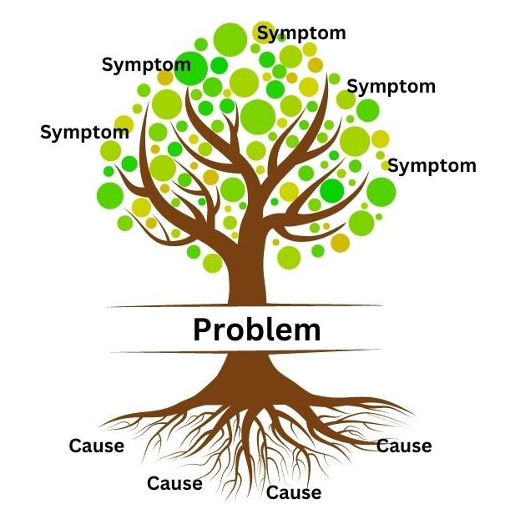
Root Cause Analysis
Identifies causes associated with a problem of interest​ – Treats cause and not symptoms
Detects why issue is present
Core Principles of Root Cause Analysis
All team members have the same goals
Focus on processes not individuals
Use open and honest communication and learn from experiences
Decisions based on data and facts
Family focus
Systems thinking
Notes:
To really kick off the PDSA cycle and begin the Plan phase we need to conduct a root cause analysis of the topic you have selected for your CQI project.
A root cause is working to understand an initial cause in a causal chain leading to an outcome in this case an issue that you would like to improve for your program. ​In other words, it is working to identify all the underlying issues that might be causes the problemed area, and the pathway that is leads to the problem area. When CQI teams understand what exactly is causing an issue they are more likely to develop a change strategy that will be successful in alleviating that issue. Meaning that we are treating the disease and not the symptom here because if you don’t identify the root cause of the issue then what will happen is that CQI teams might then temporarily alleviate the issue but it will come back because the key thing that is causing something to happen hasn’t ben addressed.
There are some key things for CQI teams to keep in mind as they are beginning to work on this process.
All team members have the same goals - this is key here as you worked together through what is your AIM statement keep that in mind when you are working on the root cause. What is your ultimate goal and how can identifying that issue lead to this.
Focus on processes not individuals - this is to help the team keep in mind that the issue is persistent in the system and not to blame others for the issue that has been identified. For example, if the service plan is not being entered because it might be the oversight of someone in the program, the team should ask themselves was this apart of their onboarding training, is there a system that can be developed from this project that could remind this individual to enter the information? Pointing fingers will not address the issue since it might persist even after that individual has left the program.
Use open and honest communication and learn from experiences - this goes in line with creating safety within the team/ Everyone should feel comfortable with sharing their perspectives on the topis as it might be the reason you are able to identify the root cause.
Decisions based on data and facts - this is to keep the conversation surrounded by what you are seeing in your data (which we will touch on during the steps to conduct a root cause analysis). It is meant to keep to team on track and keep from biasing the ideas that are going to be put forth.
Family focus - keep the focus on how this will improve service delivery to families, but also when it is relevant and you have family members on your CQI team to make sure to really listen and make sure you understand their perspective in offering their idea on the topic.
Systems thinking – think about how the change to the systems will make the program work more efficiently. What is it about how things are operating that is potentially causing the issue your team has identified.
It’s important to keep in the back of your mind here that if you did the first two steps of the CQI process well achieving these core principals will be much easier. Thinking about you’re the team you build, diverse teams will have diverse perspectives about why the issue exists, such as having community and/or family members and service staff can help push a family focus on the issue and keep a system approach to the thinking about the root cause. This will also provide a more diverse perspective and viewing of the issue to what might be causing it and also how to approach dealing with it.

Slide 8
Root Cause Analysis – Steps to Conduct Analysis
Reiterate your topic
(Re)Gather data
Identify causal factors
Determine the root cause(s)
Using your Root Cause Tools
Develop change strategy
Notes:
Reiterate your topic. Reiterate what you see happening, and identify the specific symptoms your team sees with your topic so that you can state or re-state your AIM statement. For example if you see that families do not have a service plan there might be activities that are going utilized tom alleviate their risk factors.
(Re)gather data. Before you can move on to identifying the underlying problems, you must recollect and evaluate all aspects of the situation. Look at the proof that you have found that the issue is present, and how long that has occurred. If you have time, and in line with step 1 maybe look to see if there are additional consequences of the issue persisting in the data (i.e. what additional issues might your program be experiencing because of this issue?).
Identify causal factors. Now with your data in hand, it’s time to look for as many causal factors as possible that could have led to your problem. This means thinking about how you can view each step in the process you are working to improve so that your team might pin point where things are not being efficient. Openly discuss what might have lead to your topic/issue. Are there systemic issues that we are seeing within the program that allow it to continue, and are there other issues surrounding the central issue as well? During this stage, identify as many causal factors as possible. Too often, people identify one or two factors and then stop, but that's not sufficient. With RCA, you don't want to simply treat the most obvious causes – you want to dig deeper.\
Determine the root cause(s). Use some of the root cause analysis tools that we will cover shortly to discover the root cause(s) of your issue.
Develop change strategy. Once you know the root cause, you can really dive into what the plan stage is doing by developing a change strategy to ensure the problem never happens again.

Slide 9
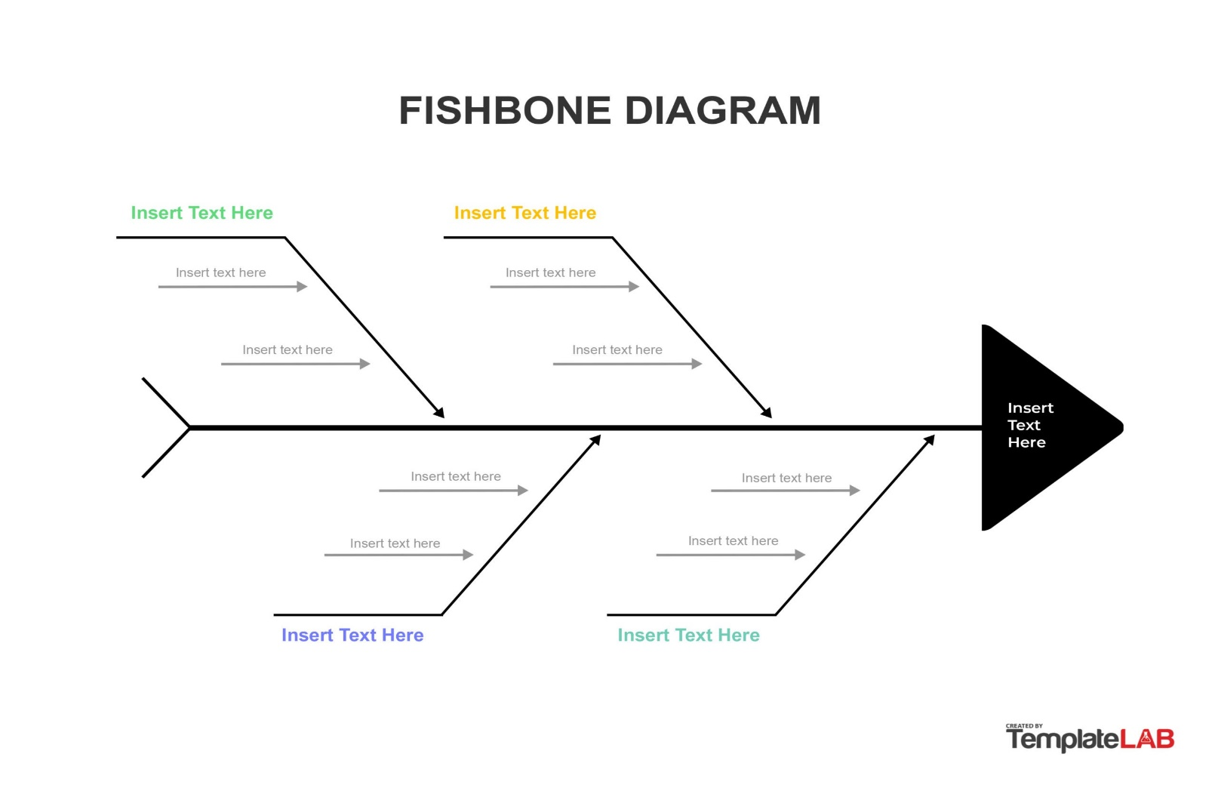
Root Cause Analysis - Tools
5 Whys
Fishbone Diagram
Brainstorming
Notes:
Now that we have covered the principals and the major steps you do to conduct the root cause analysis lets get into the “how” i.e. what are the tools you could use to conduct your own root cause analysis.
We’re going to discuss three of those methodologies which are the 5 whys, fishbone diagram, and brainstorming. There are more such as (appreciation, and drill down) but for today we are going to be focusing on these three with the most details going into brainstorming since PCANY’s guide really covers the others so well.

Slide 10
Root Cause Analysis – Tools – 5 Whys
Notes:
The first method is known as the 5 Whys.
The purpose of the 5 Whys activity is to start asking “why” questions pertaining to the issue with the intention being that the CQI team works back to identifying the root cause. The CQI team starts by asking the first why question that pertains to the issue. Typically, this method can start with “Why is this issue happening?”. The scribe then records the answers given by the team which then becomes the basis for the next question. The why questions become more and more detailed until the last response represents the root cause. It is important to note that a CQI team might ask less or more than 5 why questions, asking specifically five questions is not a rule.

Slide 11
Root Cause Analysis – Tools – Fishbone
Notes:
Fishbone diagram (see example after this paragraph) (also known as a cause-and-effect diagram) provides a visual representation of the possible root causes of the issue. The fishbone diagram consists of multiple parts which are the head, spine, ribs, and lines. All parts in the diagram help a CQI team pinpoint where they want to target their change strategy and how to plan their PDSA cycle.
Head — The fish head represents the primary issue for which a CQI team is attempting to determine the root cause.
Spine — The spine connects the issue to the ribs of the diagram.
Ribs — The ribs represent the major categories where the root causes of the issue are organized. It helps to use categories for the ribs as they help with identifying broader categories for the diagram. Label categories should use terms that are easily understood and make sense given the community prevention context.
Lines — The lines connected to the ribs are the root causes associated with the ribs categories. As with the 5 Whys, it’s possible to continue identifying causes to stem off an already identified cause (resulting in multiple lines), but it’s sufficient to only have one level of lines off the ribs.

Slide 12
Root Cause Analysis – Tools – Brain Storming
Rules
No judgement
Outside-of-box thinking
Volume
Build on each other
Record everything
Smaller is better
Notes:
Brainstorming is more abstract than 5 Whys or fishbone diagram. Brainstorming is a group approach that is used to generate thoughts about what might be the root cause of the issue and the strategies to overcome that root cause. Brainstorming might be a method a CQI team should consider using after specifics of the issue are identified with either the 5 Whys or the fishbone diagram. Once a brainstorming session is complete, there is supposed to be an opportunity for analysis after the ideas are developed (examining it with existing data), ideas are supposed to be grouped by categories, and thinking through ‘why’ (is this an issue) and ‘how’ (will this achieve the desired goal if any suggestions become a change strategy).
Do not judge others’ ideas. No ideas are more or less important than others. No use of positions or titles in the process. Take turns while sharing ideas.
Encourage out-of-the-box thinking.
Generate as many ideas as possible.
Build on ideas. Encourage team members to expand on the presented ideas and suggestions.
Record all ideas.
When the CQI team is developing a change strategy the smaller the test the better.

Slide 13
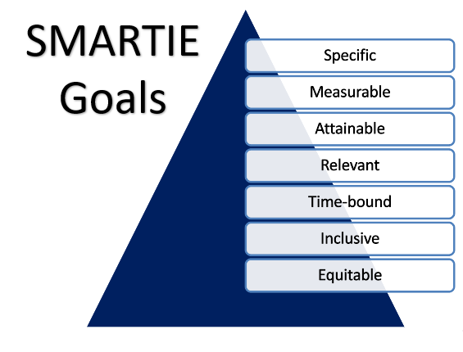
Root Cause Analysis
Notes:
Once you’ve done all that ground work and you feel that your team has identified the root cause of the issue this is one of those step back before going forward moments causer the team does need to revisit the SMARTIE goals making sure that the root cause of the issue still aligns with each component of the SMARTIE goal and the AIM statement. If all the SMARTIE criteria are still being meet then the CQI team gets to move onto the next portion of the Plan stage in the PDSA cycle.

Slide 14
Plan
What is the objective of the test? ​
How will you measure the impact of the test?​
Process Measures – Analyzes Implementation
Outcome Measures – Analyzes Success
Balancing Measures – Analyzes Unintended
Consequences
What is your plan to collect the data needed?​
How will you analyze your change strategy?
Plan
Do
Study
Act
Notes:
Okay so now that we have looked at the criteria we need to think about for our topics and a broad sweeping tool to identify where we might need to focus out targets lets move on to this next component of Plan stage, once the CQI team has identified the desired area for improvement, what they believe is the root cause of the issue and the potential solutions, and made sure they have revisited the smartie goals and AIM statement to see if the root cause aligns with that. The team will then develop a strategy to achieve a solution to the issue. This is basically how the CQI team wants to try and alleviate the issue. So if you think that the Service plans are not being entered because maybe they are being discussed but not entered right away into the MIS the change strategy could be that there is a block of time set aside for supervisors to work on MIS data entry. That's your change strategy. For 1 week there will be 2 hours of time blocked off for supervisors to enter data. You then at this stage need to develop a timeline for implementation of your change strategy, what data you need to collect for evaluating your change strategy, and an analysis plan to evaluate your change strategy.
In order to evaluate your change strategy you will need to collect 3 different types of measures. These are:
Process Measures - Used to understand how the change strategy was implemented - so for the example I gave you, you would make sure for example that supervisors actually used 2 hours of their time for data entry.
Outcome Measures - Used to determine the results of the change plan and whether it was successful or not - this would be where you could use the MIS and see if the number of PC1s increased with having a service plan.
Balancing Measures - used to identify if the change plan had any additional unintended consequences (e.g. delayed data entry from staff). - for our example, this might be that supervisors might then not get to other tasks because they have to use the time to work on data entry. This would be an unintended consequence so it would be up to the CQI team to think about how they might overcome that issue.

Slide 15
Do
Have you implemented your change strategy?
Are you collecting data on your 3 measures at regular intervals?
Have you made any adjustments to the change strategy based on your interactions with the data?
Plan
Do
Study
Act
Notes:
this is where the CQI team will implement the strategies of the plan for a set period. During this initial do phase the CQI team should only conduct a small test to reduce the risk of large failure (provide details and explanation of the power of one test). It should build on itself sequentially until the change plan is enacted program wide.
Implementing change strategy
Collecting data at regular intervals

Slide 16
Study
What did you learn about your change strategy?​
Have you discussed the results?
How has your team summarized this information?
Plan
Do
Study
Act
Notes:
Through regular intervals of conducting the project, programs will need to collect data on the three measures (process, outcome, balancing) and study the results based on the collected data up to that point. Programs will need to carefully analyze the results and the implementation of the change plan.

Slide 17
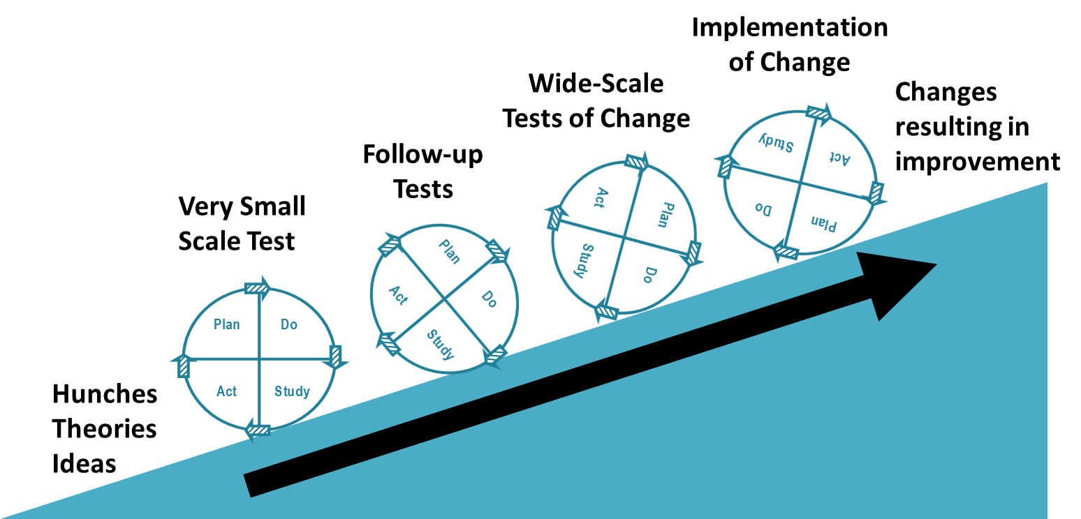
Act
Adopt​
Implement Change Strategy Program Wide
Scale Up Test
Adapt​
Abandon
Plan
Do
Study
Act
PDSA Scaling Process
Notes:
Once the Plan Do and Study steps fourth step begins which is Act. This is where the based on what the CQI team has discovered in the Study step make a decision on what to do with the change plan. The CQI Team really has three options which are adopt, adapt, and abandon.
The first is Adopt.
Adopt – if the change plan produced the desired results and was implemented as designed then the CQI can adopt the change strategy, but that does not stop there cause they have two options that come with adopting a change strategy.
The first is that if the change strategy worked and the CQI team feels there is no additional information needed on how the change strategy will work on a larger scale then they can implement the change strategy program wide, and it is done.
The second option is to scale up/increase the size of PDSA process within a ramp cycle. Even with that there are a few things for CQI teams to consider: If the first test of a change strategy yields promising results and changes are minor, it can be scaled up because there is evidence the change strategy works and big failures are unlikely.
The scaling process should be purposeful and iterative.
Each new test of a change strategy should be clearly related to the last test.
The scale of the test should be increased by just one increment at a time. Depending on the test, one increment could be one client or one home visitor.
Tests of change strategies should be scaled (up or down) based on results.
The second broader option is Adapt.
- Adapt – if the project did not produce the desired results or was not implemented as intended but the possibility of making changes is available then it should be adapted and retested in another PDSA cycle.
- Abandon - if the project did not produce the desired results and the possibility of making changes is not an option, then the action should be to abandon the change plan.

Slide 18
Example
Notes:
Now that we broadly know the concepts behind a PDSA cycle I am going to give a broad example of what this could look like and I do not mean for this to be incredibly detailed or really to completely follow every single tip/methodology we have discussed, but is a way more for us to reflect on the process for how the process could look and how it is implemented. First we are going to assume that this program has formed a CQI team and that we know that this team is going to do service plans as their topic. They begin engaging with the data by looking through the MIS specifically the Service Plan Analysis Report and this program finds that at the moment that 30% of PC1s have a service plan. So they choose for this project to increase the number of PC1s with a service plan.
They then check to make sure that this topic follows the SMARTIE approach.
Specific –For example because the program found that 30% of PC1s have a service plan they decide that by September 30th 2023 they would like to have 60% of PC1s with a service plan.
Measurable –The Percent of PC1s is measurable since we have a report in the MIS that tells us the percent.
Attainable –I would argue goal is attainable, it is not going for a perfect rate and recognizes that there is not a perfect completion rate might not be realistic initially.
Relevant –It is relevant in that it is creating more fidelity to the BPS model, and improving rates of service plans can help improve the services delivery for those families as it is formalizing the process of planning activities for the families being served.
Timely –It is timely as the CQI team will assess what the PC1 service plan rate is by the end of September 30th this year.
Inclusive –The CQI team might include everyone at all levels in their program for input into the topic – it might be that they determined too that families might not be able to help with his topic as much but do assess if the prevalence of service plans is evenly distributed for them. .
Equitable –The change plan/CQI project will apply to all PC1s in the program and the possible changes to practice will apply to all staff who are involved with working on service plans if that change can be enacted.
Everything looks good so the CQI team then decides to move onto the 3rd CQI process i.e. the PDSA cycle itself.
The CQI team decides to have a focus group with all staff members in the program to gather information on what might increase completion rates. Once they have gathered that information, the CQI team holds a brainstorming session in combination with engaging with the feedback from the focus group, they find that supervisors do discuss the risk factors of the family but they do not enter that information into the MIS either because of not having enough time/ want to add more details outside of the meeting, and other work pulls them away from entering this information. The CQI team feels that they have found the root cause of the issue through the brainstorming analysis and move onto developing a change strategy.
The change strategy the team develops is a weekly reminder for supervisors to take 2 hours to enter the information in to the MIS, and request an MIS data entry session with CHSR to review with all staff in the program. They are going to implement the change plan in June with the major outcome being increasing the percent of PC1s with a service plan monitored through the MIS.
Once they have developed the change plan, they begin the do and initial study phase, and this is where the success story can be seen. They establish that 30% of PC1s have a service plan. They integrate their change plan find that between June and July that they already meet their goal of 60%. Because they were already successful at meeting their goal with The initial change plan the CQI team decides that they have an opportunity to create more success so they revamp their change plan. They adjust the change plan so that there are now 2 reminders and time should also be used to retroactively add in service plans for existing PC1s.
The CQI found that the change plan was enacted the way they had planned and that there had not really been any unintended consequences work loads were not significantly impacted, and eventually supervisors made it apart of their daily routine to enter information into the MIS. Based on this they decide to enact this change plan permanently for the program, with the decision that they will continue to monitor the measures they developed for anything that pops up. And begin to then think about how they can now bolster up conversations around service plans in supervision with home visitors.
We can see how this process can play out especially since the CQI team really interacted with the data and demonstrates here that continuous interaction with their data can really foster new improvements and changes to the service plan during implementation.

Slide 19
Example
Notes:
Now I will be honest that example is a perfect nothing goes wrong example. It might be in real life that possibly you did that change plan with one supervisor. And it turns out that supervisor decided to leave in the middle of the study of the change strategy. So we might see something like this happen that we get a drop in the number of the PC1s with a service plan because a new supervisor needs to eb trained but once they do and are apart of the change strategy as they start the program might see that it works great and there is still an increase by the deadline.

Slide 20
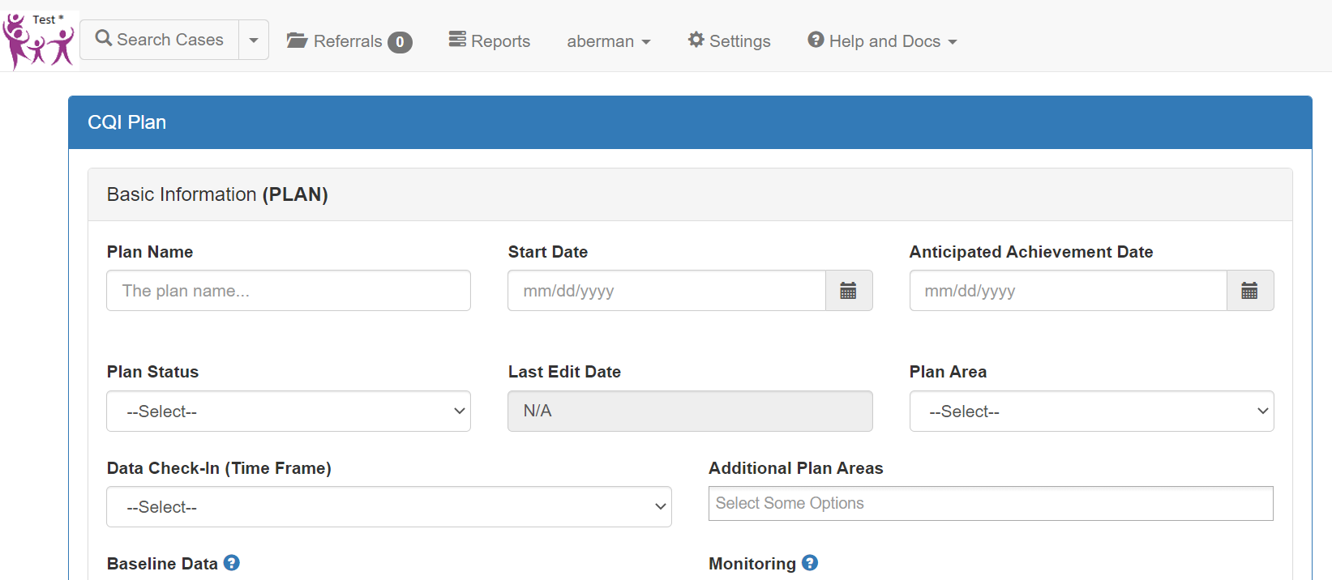
Review MIS CQI Module

Slide 21
SERVICE PLAN OVERVIEW (PCANY)
The Service Plan
Ongoing Use of the Service Plan
Service Plan Discussion in Supervision

Slide 22
SERVICE PLAN Resources (PCANY)
Service Plan Handbook for Supervisors
HFNY Website ​ (Must be logged in to access)
Transfer of Learning Website ​
Service Plan Spotlight - click on "Handbooks', 'Service Plan Videos'
Guidelines for Supervision Notes
HFNY Website ​ (Must be logged in to access)
Transfer of Learning Website ​
HFA BPS 6-1
HFA BPS
HFNY Policy & Local Procedure
Service Plan Office Hours - 7/10/23

Slide 23
Work for In-between Month (May)
Complete and fill out sections: Tracking Success, Root Cause Analysis Conducted, SMARTIE Aim Statement, Project Description, and 1. Plan of the PDSA Form.*
Complete and fill out section (Basic Information (PLAN) in the MIS CQI Plan Form.
*Note: You may fill out the later sections of the PDSA form but you do not need to complete your CQI projects at this time.
Notes:
Language around service plan needs to be thought of as strength based when programs are talking about outreach to families to be on the team. Transparency

Slide 24
Additional Resources
​
HFNY CA - CQI Guide​
HFNY Website Program Manager Tab
CQI Toolkit Handouts
Service Plan MIS Video
Notes:
Every case needs a service plan
The SP on the MIS was updated when the FROG went live. It now includes the 14 domains and pulls the scores for PC1 and PC2 from the completed FROG (it follows the HFA plan but is a little bit better because it has the priority box that helps with ‘pacing’ as 6-1.A requests.
Now that we are switching to a one-step, the Service Plan has moved to the after-enrollment column in the case home page and is open as soon as the ID-Contact Form has been entered.
Aside from the Service Plan analysis report and the Supervision activities report we are currently working on a new Case Supervision Discussion History Report (see mock-up attached) that will make it easier for programs to search for in-depth discussions where among other things Protective and Risk factors and the Service Plan should be discussed and documented. If staff document using dates on the planning and implementation columns on the SP as trained, it will be easy for them to search for the supervision where discussions took place and HVLogs where plans were implemented.
Do you know what the plan is to capture 6-1.C. Based on peer reviewer training it is looking like reviewers will be looking for evidence of implementation of SP activities with families. I believe that peer reviewers will be looking at the SP’s last two columns (plan and implementation) and checking the supervision notes to see what was planned and the home visit logs to see how those plans were implemented with the family. That is why it is important to follow the instructions on how to document (write dates before any text in those two columns) to make it easy to find the discussions on the sup notes and activities or referrals on the HVLogs.

Slide 25
Thank you! What questions do you have? We’ll see you on June 15th!

